Slide 1
Result of 1D GAN for MoG
Junyeob Kim

Slide 2
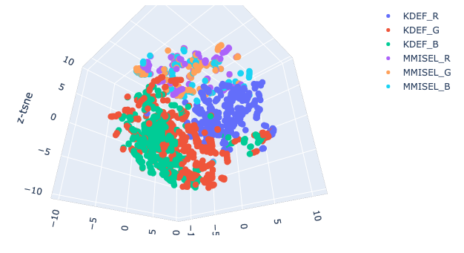
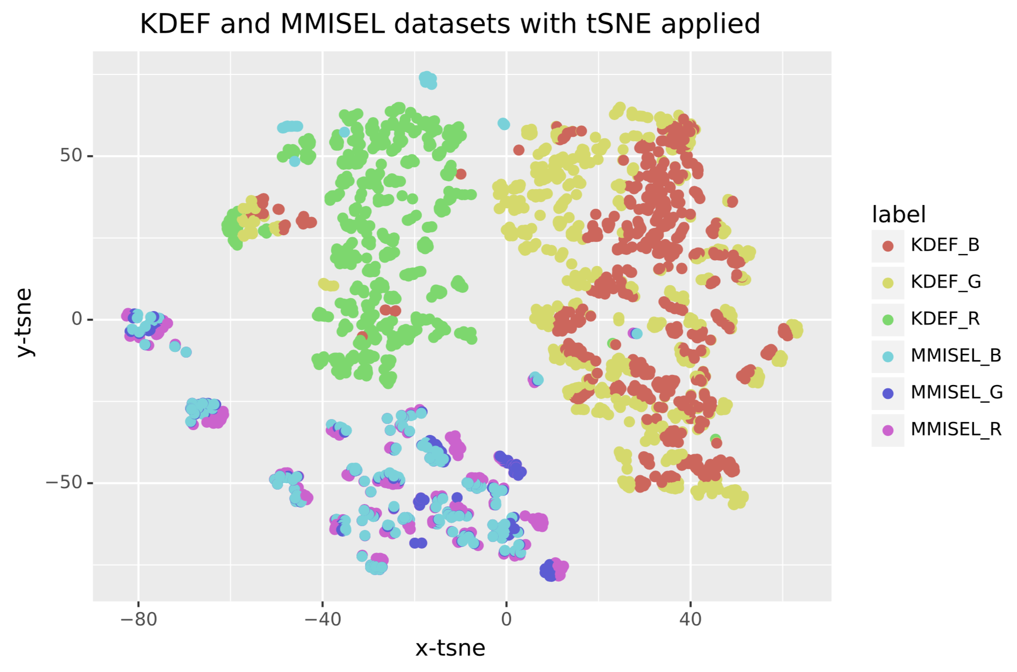
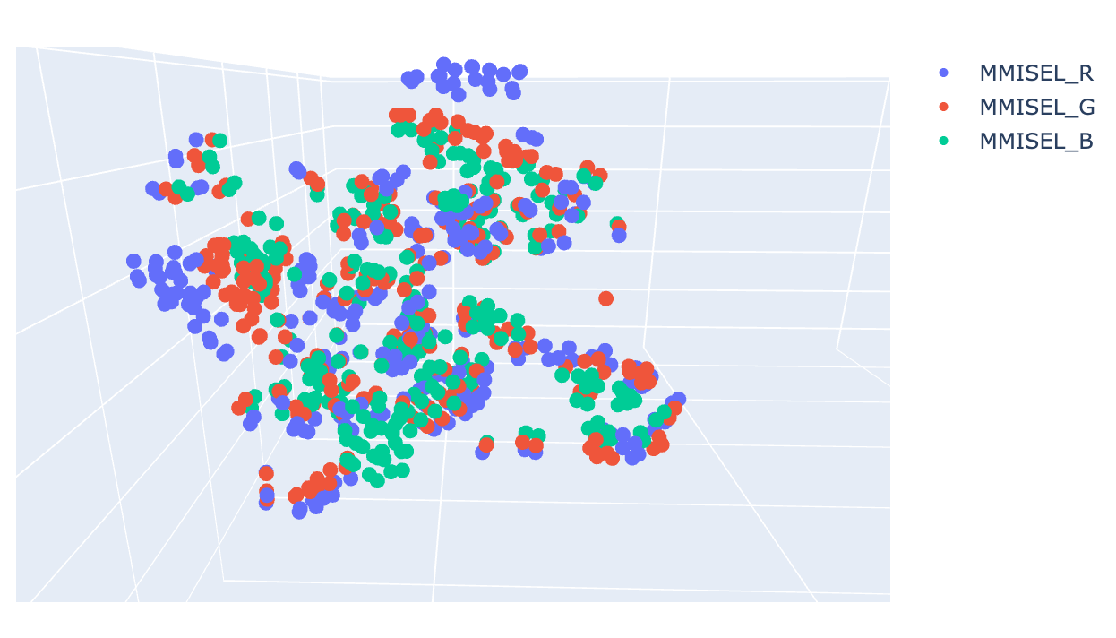
T-sne for MMISEL and KDEF
Left: graphs of 3d tsne, rotated for better visualization.
Right: graph of 2d tsne

Slide 3
Notes
Created 1D GAN with 1D Convolution
5000 sets of 28*28 array for training and validation
Different random seeds
500 sets of 28*28 array for test
10 different random seeds
Samples are flattened for use as 1D
Loss function for Generator and Discriminator – cross entropy
Error function used for testing – mean squared error

Slide 4
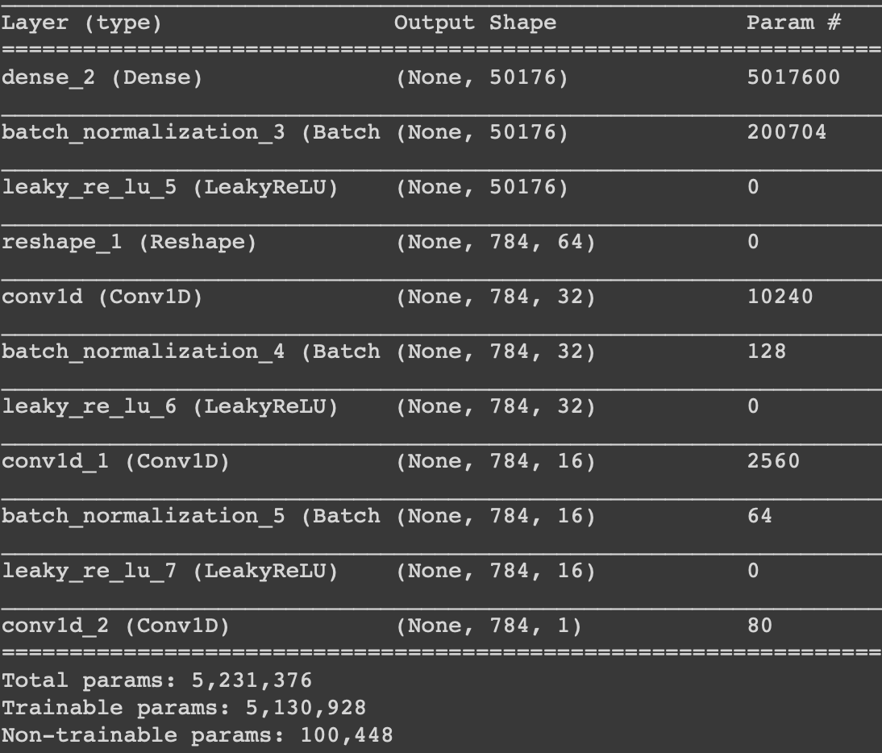
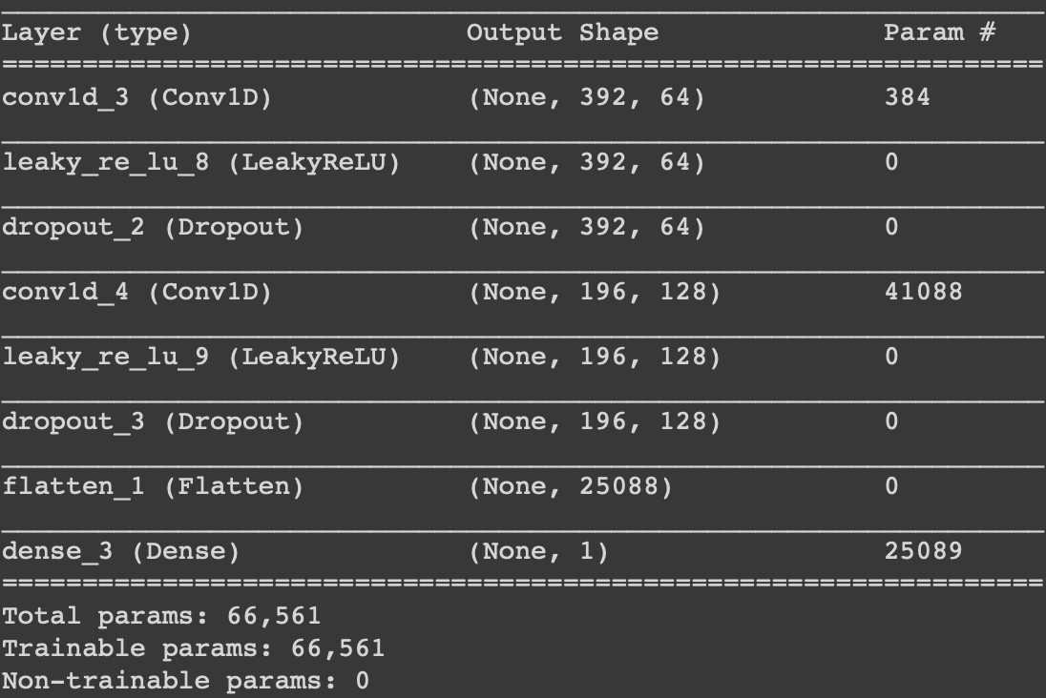
Model Summary
Generator
Discriminator

Slide 5
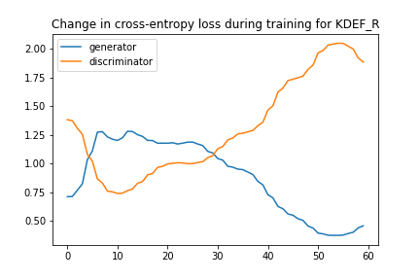
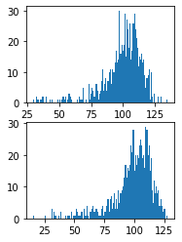
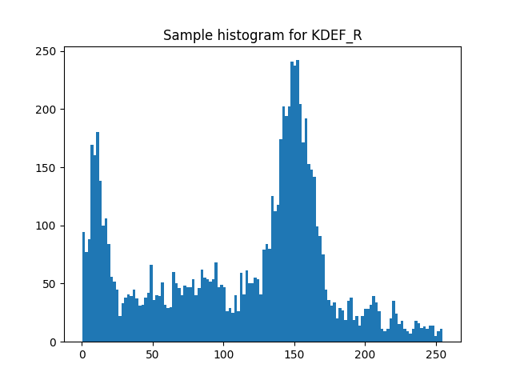
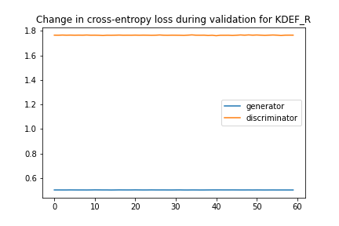
Result for KDEF_R
Left : generated image, Right : input image
Resulting error : 0.27114850461483003

Slide 6
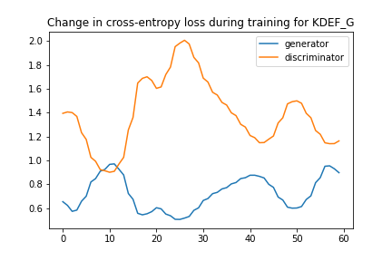
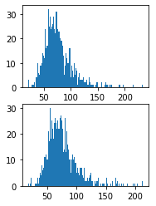
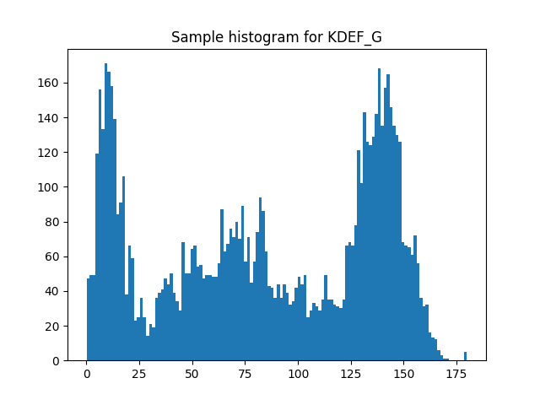
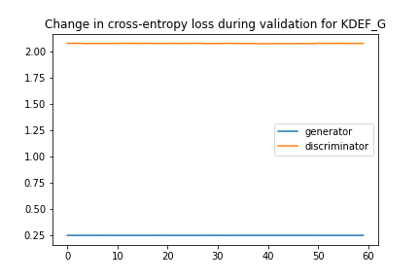
Result for KDEF_G
Left : generated image, Right : input image
Resulting error : 0.21063432186841965

Slide 7
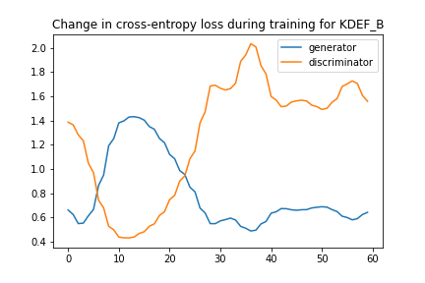
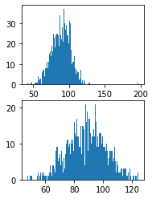
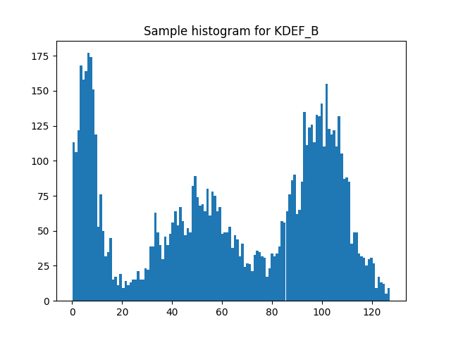
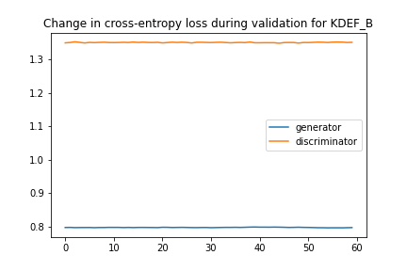
Result for KDEF_B
Left : generated image, Right : input image
Resulting error : 0.14602848514914513

Slide 8
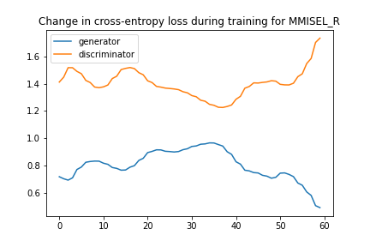
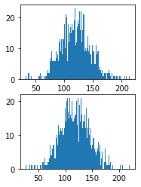
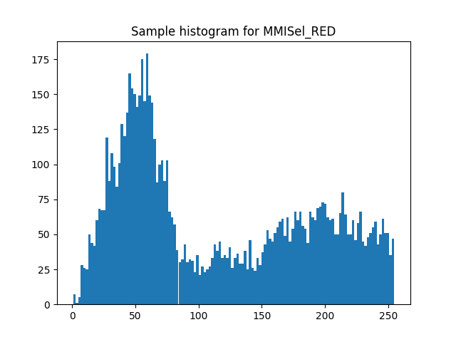
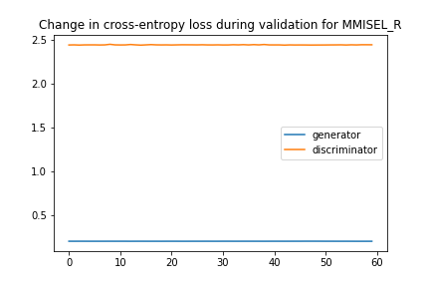
Result for MMISEL_R
Left : generated image, Right : input image
Resulting error : 0.378349711894989

Slide 9
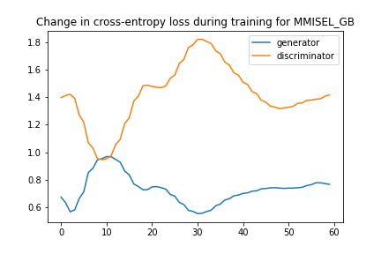
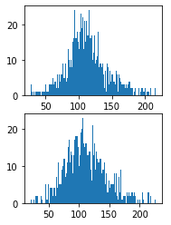
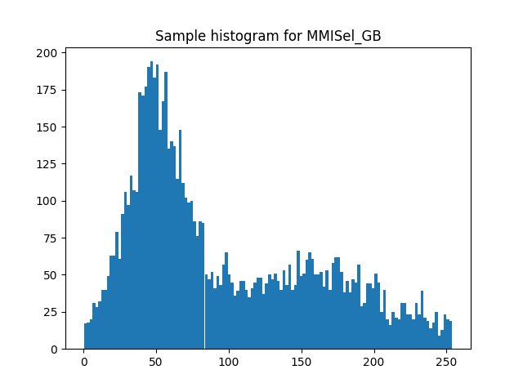
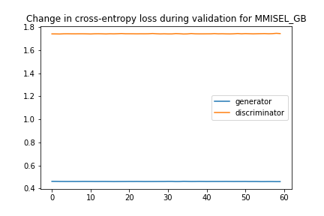
Result for MMISEL_GB
Left : generated image, Right : input image
Resulting error : 0.3102135434746742

Slide 10
Conclusion
By comparing the generated image and the input image (from inverse transform sampling), it is possible to conclude that the model is trying to generate a distribution where its peak is located at central point -the average value of the input sample.

